Slide 1
THG HOTEL
COMPANY PROFILE
Group Rethink
ShuJie Chen
Chengyu Ma
Claire Wang
Victoria Xiang
Tonghao Zhang
Notes:
THG Hotel management company

Slide 2
THG Hotel
THG BUSINESS PROBLEM
RETHINK
CHALLENGE MISSION
GROWTH RATE
BRAND VALUES
The book rate is increasing at a low rate in recent years
Difficult to raise the price with the existing brand image
Labor, materials, and utilities costs have surged, exerting pressure on profit margins
Notes:
Higher Costs

Slide 3
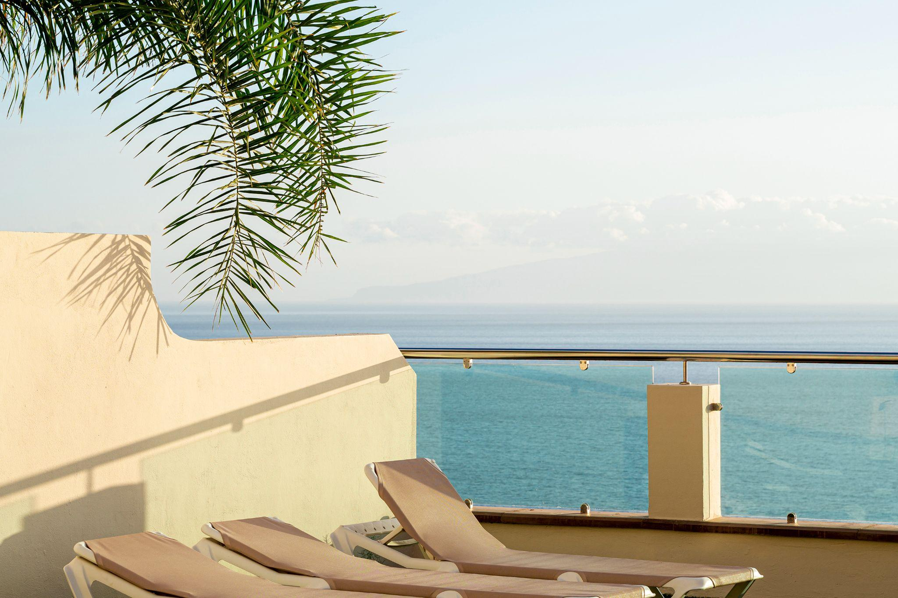
THG Hotel
Strategy: Leverage Core Competencies
RETHINK
·01·
Core Value
Bring quality and surprising service to every customer at a friendly cost
·02·
Better Service
Modify existing services. Introduce new services, both free and optional for pay
·03·
Efficient Operation System
Eliminate operational waste and minimize costs to create rooms for profitability

Slide 4
THG Hotel
Add Value
·01·
RETHINK

Slide 5
THG Hotel
Effects on Profit Making
RETHINK
Higher Customer Retention Rate
More Memberships & More Loyal Customers
Better customized service leads to more returning visitors
Rooms are more likely running fully operated with more loyal customers
More Service Options for Customers
Higher Profit Margin
More service options means better chance to generate profits
Better facility infrastructure and system can lower down the daily operational cost

Slide 6
THG Hotel
Involvement of Assets and Customers
RETHINK
Existing Assets & Customers
Renovation required for some existing rooms and facilitated assets. Previous customers will need the chance to know and experience the new service offered by the hotel
New Assets & Customers
New assets will be purchased for the new business model. New customers is welcomed to spend the stay at THG with the customized services at their choice

Slide 7
THG Hotel
·02·
Feasibility
RETHINK

Slide 8
THG Hotel
Change One?
RETHINK
Digital Service Enhancement
·1·
Digital mobile app with features such as digital room key and automatic check-in/check-out
Special Rooms at Limit Offerings
·2·
Thoughtfully designed rooms with seasonal themes
More Offerings with Local Partnerships
·3·
Offering coupons to the local restaurants

Slide 9
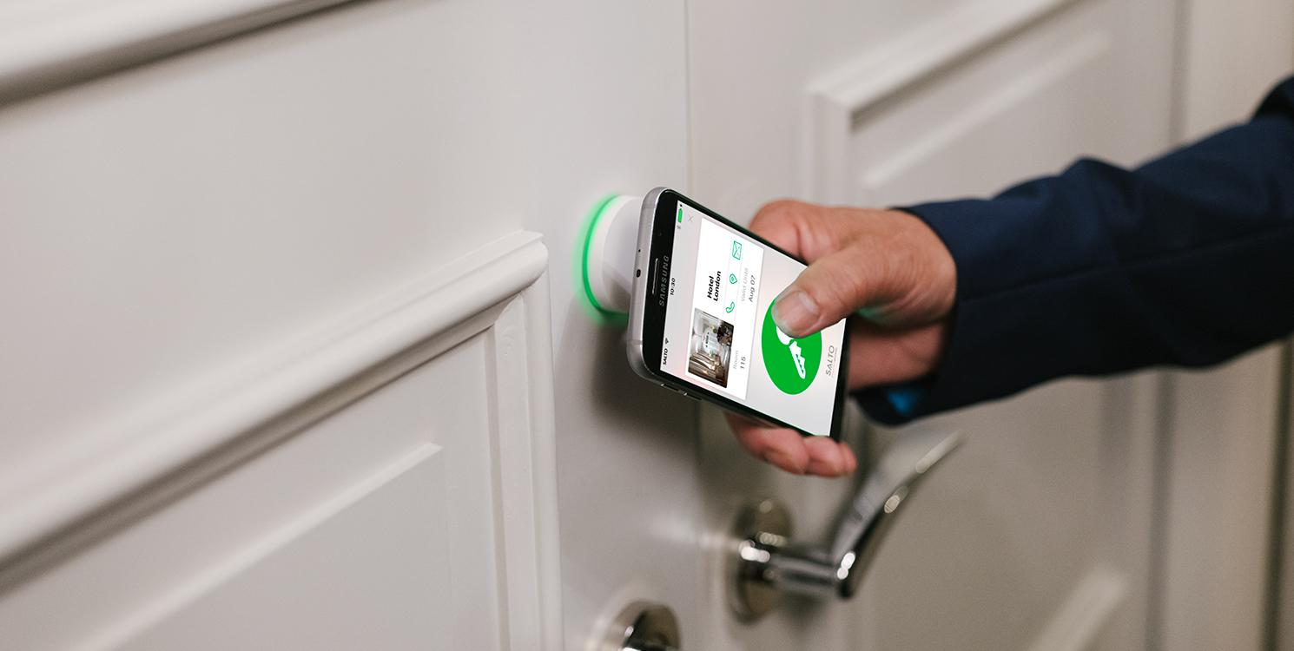
Digital Service Enhancement
RETHINK
Digital mobile app with features such as digital room key and automatic check-in/check-out

Slide 10
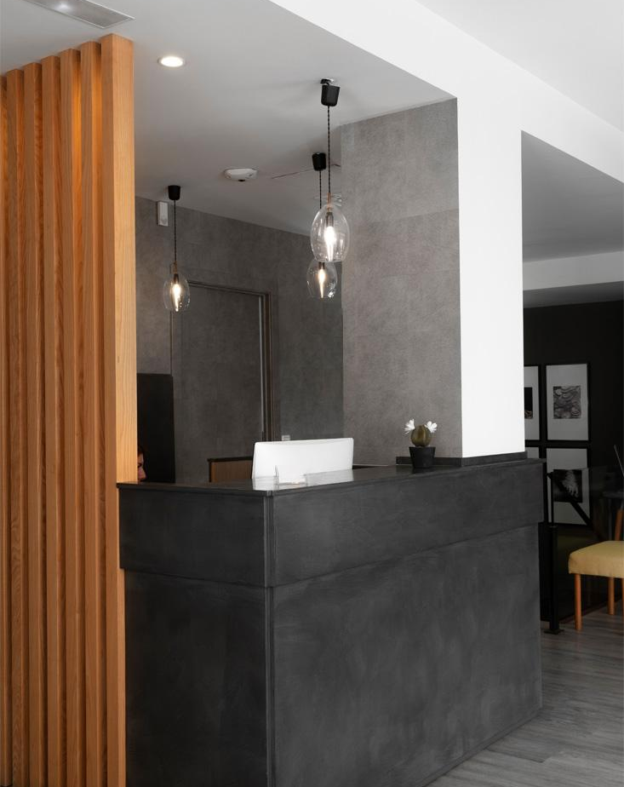
Special Rooms at Limit Offerings
RETHINK
Thoughtfully designed rooms with seasonal themes

Slide 11
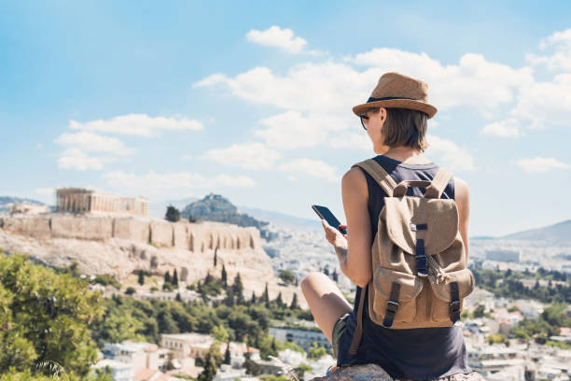
More Offerings with Local Partnerships
RETHINK
Offering coupons to the local restaurants

Slide 12
THG Hotel
·03·
Using analysis to convince the client to implement it
RETHINK

Slide 13
THG Hotel
Market Analysis
RETHINK
Market Growth
The hospitality industry is experiencing steady growth, albeit with cost challenges
Client Segmentation
Identified target segments with potential for growth and profitability
Notes:
The hospitality industry is growing fast, but cost challenges still exist. Our competitors are also investing in similar strategies to attract customers. Through client segmentation, we have identified target markets with potential for growth and profitability.

Slide 14

THG Hotel
Financial Analysis
·01·
Cost Trends
Costs are on the rise, impacting overall profitability
·02·
Revenue Potential
Attracting transient customers and securing group contracts can significantly boost revenue
·03·
ROI Projections
Projected returns on investment based on increased sales and market penetration
Notes:
Costs are on the rise, it's affecting how much the company can get. However, attracting customers can enhance the revenue, with substantial projected returns on investment.

Slide 15
THG Hotel
Customer Analysis
RETHINK
·01·
Transient Customer Trends
There's a growing demand for unique experiences and personalized services among transient customers
·02·
Group Contract Preferences
Venues offering versatile facilities and value-added services are preferred among groups
·03·
Customer Satisfaction Impact
Meeting customer needs leads to higher satisfaction levels and increased repeat business
Notes:
Moving on to customer analysis, customer trends indicate a growing demand for unique experiences and personalized services. Meanwhile, offering versatile facilities and services are preferred among groups. Meeting customer needs will lead to higher satisfaction levels and increased repeat business.

Slide 16
Getting Data
Engage with reputable market research firms
IBISWorld, Forrester Research and Gartner, etc
Customer surveys & focus groups
valuable primary data & customer segments & revenue patterns
Industry conferences and networking events
Projections and model

Slide 17
THG Hotel
·04·
IMPLEMENTATION
RETHINK

Slide 18
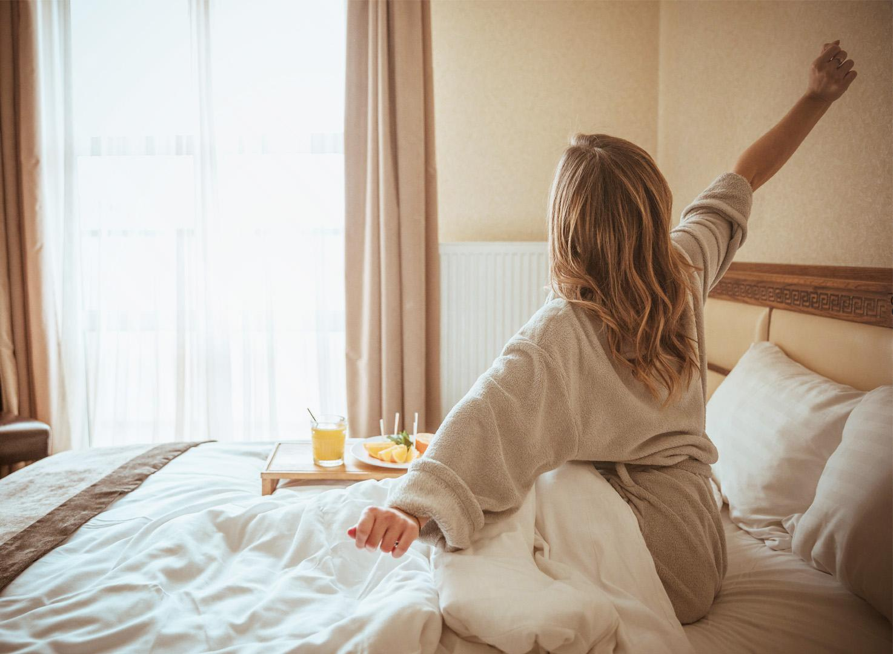
“How” of Strategies
RETHINK
1. Value: Developing Personalized Packages and Loyalty Programs:
Analyzing customer preferences and behaviors to create tailored packages for different traveler segments. Eg, business travelers, families, leisure guests, etc
Implementing a loyalty program that rewards repeat customers with points for their stays, upgrades
Offering personalized experiences and incentives
Notes:
Strategy: Leverage Core Competencies

Slide 19
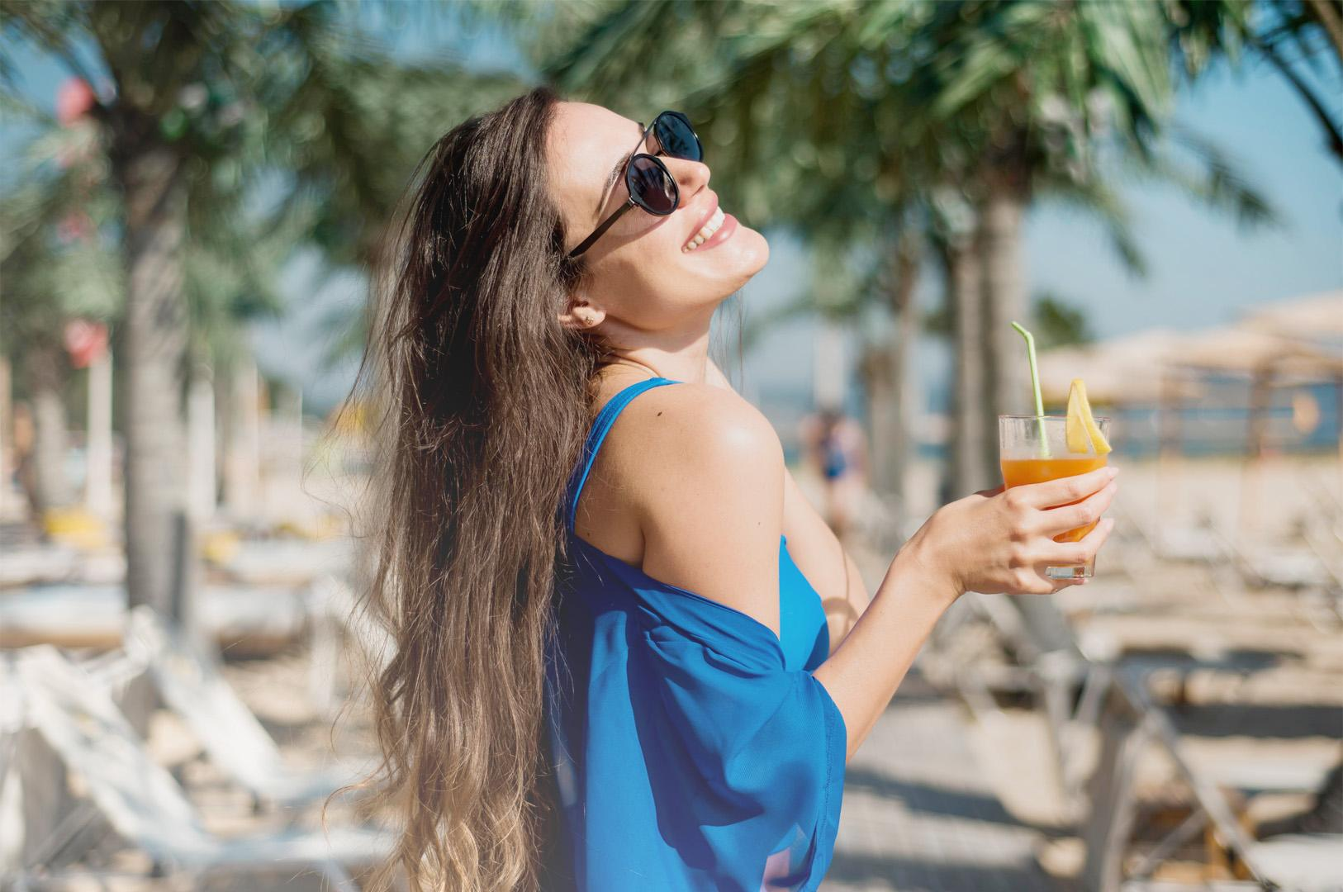
“How” of Strategies
RETHINK
2. Value: Bundling New Products with Existing Ones
Combining accommodation with additional services or experiences to create value-added bundles for guests
Creating seasonal or event-based bundles can attract guests during peak periods
Notes:
THG Hotel can partner with local tour operators, restaurants, or wellness centers to offer packages that include accommodation and activities like city tours, spa treatments, or dining experiences.

Slide 20
“How” of Strategies
THG Hotel
RETHINK
3. Better Service: Focusing on High-Margin Services:
Identify and prioritize offerings that yield the highest profitability, eg.premium room upgrades, spa and wellness services, and upscale dining experiences
Optimizing operational efficiency and cost management in delivering these services
4. Leveraging Core Competencies in New Contexts:
Applying THG Hotel's core competencies, such as event management and hospitality training, in new contexts to create additional revenue streams
Notes:
For instance, the hotel can expand its event hosting capabilities and offer conference services to corporate clients, leveraging its expertise in organizing seamless and enjoyable experiences.

Slide 21
THG Hotel
Specific Steps
RETHINK
Value:Developing Personalized Packages and Loyalty Programs
Conduct Market Research
Implement Loyalty Program
Monitor and Adjust
Design Tailored Packages
Train Staff
Notes:
1. Conduct Market Research: Identify customer segments and their preferences through surveys, feedback analysis, and data analytics.
2. Design Tailored Packages: Create personalized packages for different traveler types based on their preferences and needs.
3. Implement Loyalty Program: Develop a loyalty program that rewards repeat customers with points for their stays and encourages engagement.
4. Train Staff: Educate employees on the personalized packages and loyalty program to effectively promote and deliver these offerings to guests.
5. Monitor and Adjust: Continuously analyze customer feedback and program performance to make necessary adjustments for improvement.

Slide 22
THG Hotel
Specific Steps
RETHINK
2. Value:Bundling New Products with Existing Ones
Identify Partner Opportunities
Create Package Options
Collaborate with local tour operators, restaurants, and service providers
Marketing and Promotion
Pricing Strategy
Track Performance

Slide 23
THG Hotel
Specific Steps
RETHINK
3. Better Service: Focusing on High-Margin Services
·1·
·2·
·3·
Margin Analysis·
Promotional Campaign·
Upselling Training·
·4·
·5·
Operational Efficiency·
Guest Experience Enhancement·

Slide 24
THG Hotel
Specific Steps
RETHINK
4. Leveraging Core Competencies in New Contexts:
·1·
·2·
·3·
Identify Expansion Opportunities
Develop New Offerings·
Market Positioning
·4·
·5·
Staff Training
Performance Evaluation

Slide 25
Timeline
1. Developing Personalized Packages and Loyalty Programs:
- Short Term (0-6 months):
- Conduct Market Research: 1-2 months
- Design Tailored Packages: 1-2 months
- Implement Loyalty Program: 1-2 months
- Medium Term (6-12 months):
- Train Staff: 1-2 months
- Monitor and Adjust: Ongoing refinement based on feedback
- Long Term (12+ months):
- Continuously evolve packages and loyalty program based on customer insights and market trends
2. Bundling New Products with Existing Ones:
- Short Term (0-6 months):
- Identify Partner Opportunities: 1-2 months
- Create Package Options: 1-2 months
- Pricing Strategy: 1 month
- Medium Term (6-12 months):
- Marketing and Promotion: Ongoing with seasonal adjustments
- Track Performance: Regular monitoring and adjustments based on performance
- Long Term (12+ months):
- Expand partnerships and refine bundled offerings based on guest feedback

Slide 26
Timeline
4. Leveraging Core Competencies in New Contexts:
- Short Term (0-6 months):
- Identify Expansion Opportunities: 1-2 months
- Develop New Offerings: 2-3 months
- Medium Term (6-12 months):
- Market Positioning: Ongoing with immediate actions
- Staff Training: 1-2 months
- Long Term (12+ months):
- Performance Evaluation: Regular assessment and adjustments for sustained growth
3. Focusing on High-Margin Services:
- Short Term (0-6 months):
- Margin Analysis: 1 month
- Promotional Campaigns: Ongoing with immediate implementation
- Upselling Training: 1-2 months
- Medium Term (6-12 months):
- Operational Efficiency: Ongoing optimization
- Guest Experience Enhancement: Continuous improvement based on feedback
- Long Term (12+ months):
- Establish high-margin services as core offerings and consistently enhance quality

Slide 27
THG Hotel
Evaluations
RETHINK
Financial Metrics
Customer Satisfaction & Engagement
Operational Efficiency
Revenue Growth & Cost Reduction
Profit Margins
Return on Investment (ROI)
Customer Feedback
Repeat Business
Net Promoter Score (NPS)
Utilization Rates
Staff Training and Performance
Service Quality

Slide 28
THANKS!

